Slide 1
Radio Propagation

Slide 2
Speed, Wavelength, Frequency
Light speed = Wavelength x Frequency
= 3 x 10⁸ m/s = 300,000 km/s
System | Frequency | Wavelength
AC current | 60 Hz | 5,000 km
FM radio | 100 MHz | 3 m
Cellular | 800 MHz | 37.5 cm
Ka band satellite | 20 GHz | 15 mm
Ultraviolet light | 10¹⁵ Hz | 10⁻⁷ m

Slide 3
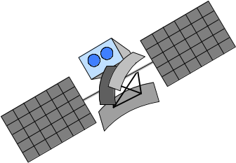
Types of Waves
Ionosphere (80 - 720 km)
Sky wave
Mesosphere (50 - 80 km)
Space wave
Stratosphere (12 - 50 km)
Ground wave
Transmitter
Receiver
Troposphere (0 - 12 km)
Earth

Slide 4
Radio Frequency Bands
Classification Band | Initials | Frequency Range | Characteristics
Extremely low | ELF | < 300 Hz | Ground wave
Infra low | ILF | 300 Hz - 3 kHz
Very low | VLF | 3 kHz - 30 kHz
Low | LF | 30 kHz - 300 kHz
Medium | MF | 300 kHz - 3 MHz | Ground/Sky wave
High | HF | 3 MHz - 30 MHz | Sky wave
Very high | VHF | 30 MHz - 300 MHz | Space wave
Ultra high | UHF | 300 MHz - 3 GHz
Super high | SHF | 3 GHz - 30 GHz
Extremely high | EHF | 30 GHz - 300 GHz
Tremendously high | THF | 300 GHz - 3000 GHz

Slide 5
Propagation Mechanisms
Reflection
  Propagation wave impinges on an object which is large as compared to wavelength
- e.g., the surface of the Earth, buildings, walls, etc.
Diffraction
  Radio path between transmitter and receiver obstructed by surface with sharp irregular edges
  Waves bend around the obstacle, even when LOS (line of sight) does not exist
Scattering
  Objects smaller than the wavelength of the propagation wave
- e.g. foliage, street signs, lamp posts

Slide 6

Radio Propagation Effects
Building
Direct Signal
h_{b}
Reflected Signal
Diffracted Signal
h_{m}
d
Transmitter
Receiver

Slide 7
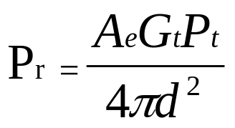
Free-space Propagation
h_{b}
h_{m}
Transmitter
Distance d
Receiver
The received signal power at distance d:
where P_{t} is transmitting power, A_{e} is effective area, and G_{t} is the transmitting antenna gain. Assuming that the radiated power is uniformly distributed over the surface of the sphere.

Slide 8
Antenna Gain
For a circular reflector antenna
Gain G = η ( π D / λ )²
η = net efficiency (depends on the electric field distribution over the antenna aperture, losses, ohmic heating , typically 0.55)
D = diameter
thus, G = η (π D f /c )², c = λ f (c is speed of light)
Example:
Antenna with diameter = 2 m, frequency = 6 GHz, wavelength = 0.05 m
G = 39.4 dB
Frequency = 14 GHz, same diameter, wavelength = 0.021 m
G = 46.9 dB
* Higher the frequency, higher the gain for the same size antenna

Slide 9
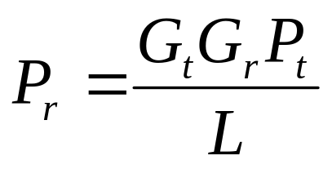
Land Propagation
The received signal power:
where G_{r} is the receiver antenna gain,
L is the propagation loss in the channel, i.e.,
L = L_{P} L_{S} L_{F}
Fast fading
Slow fading
Path loss

Slide 10
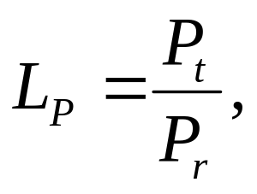
Path Loss (Free-space)
Definition of path loss L_{P} :
Path Loss in Free-space:
where f_{c} is the carrier frequency.
This shows greater the f_{c ,} more is the loss.

Slide 11
Path Loss (Land Propagation)
Simplest Formula:
        L_{p} = A d^{-α}
where
A and α: propagation constants
d : distance between transmitter and receiver
α : value of 3 ~ 4 in typical urban area

Slide 12
Channel Capacity
The maximum rate at which data can be transmitted over a given communication channel, under given conditions, is referred to as the channel capacity.
Data rate
  The rate in bits per second (bps) at which data can be communicated
Bandwidth
  In cycles per second, or Hertz
  Constrained by transmitter and the nature of the medium
Error rate
  The rate at which errors occur, where an error is the reception of a 1 when a 0 was transmitted or the reception of a 0 when a 1 was transmitted.
We would like to make as efficient use as possible of a given bandwidth, i.e., we would like to get as high a data rate as possible at a particular limit of error rate for a given bandwidth.

Slide 13
Two Formulas
Problem: given a bandwidth, what data rate can we achieve?
Nyquist Formula
  Assume noise free
Shannon Capacity Formula
  Assume white noise

Slide 14
Nyquist Formula
Assume a channel is noise free.
Nyquist formulation: if the rate of signal transmission is 2B, then a signal with frequencies no greater than B is sufficient to carry the signal rate.
  Given bandwidth B, highest signal rate is 2B.
Why is there such a limitation?
  due to intersymbol interference, such as is produced by delay distortion.
Given binary signal (two voltage levels), the maximum data rate supported by B Hz is 2B bps.
  One signal represents one bit

Slide 15
Nyquist Formula
Signals with more than two levels can be used, i.e., each signal element can represent more than one bit.
  E.g., if a signal has 4 different levels, then a signal can be used to represents two bits: 00, 01, 10, 11
With multilevel signaling, the Nyquist formula becomes:
  C = 2B log₂M
  M is the number of discrete signal levels, B is the given bandwidth, C is the channel capacity in bps.
  How large can M be?
    The receiver must distinguish one of M possible signal elements.
    Noise and other impairments on the transmission line will limit the practical value of M.
Nyquist’s formula indicates that, if all other things are equal, doubling the bandwidth doubles the data rate.

Slide 16
Shannon Capacity Formula
Now consider the relationship among data rate, noise, and error rate.
Faster data rate shortens each bit, so burst of noise affects more bits
  At given noise level, higher data rate results in higher error rate
All of these concepts can be tied together neatly in a formula developed by Claude Shannon.
  For a given level of noise, we would expect that a greater signal strength would improve the ability to receive data correctly.
  The key parameter is the SNR: Signal-to-Noise Ratio, which is the ratio of the power in a signal to the power contained in the noise.
  Typically, SNR is measured at receiver, because it is the receiver that processes the signal and recovers the data.
For convenience, this ratio is often reported in decibels
  SNR = signal power / noise power
  SNR_{db}⁼ 10 log₁₀ (SNR)

Slide 17
Shannon Capacity Formula
Shannon Capacity Formula:
  C = B log₂(1+SNR)
  Only white noise is assumed. Therefore it represents the theoretical maximum that can be achieved.
This is referred to as error-free capacity.
Some remarks:
  Given a level of noise, the data rate could be increased by increasing either signal strength or bandwidth.
  As the signal strength increases, so do the effects of nonlinearities in the system which leads to an increase in intermodulation noise.
  Because noise is assumed to be white, the wider the bandwidth, the more noise is admitted to the system. Thus, as B increases, SNR decreases.

Slide 18
Example
Consider an example that relates the Nyquist and Shannon formulations. Suppose the spectrum of a channel is between 3 MHz and 4 MHz, and SNR_{dB} = 24dB. So,
B = 4 MHz – 3 MHz = 1 MHz
SNR_{dB} = 24 dB = 10 log10(SNR) → SRN = 251
Using Shannon’s formula, the capacity limit C is:
C = 10⁶ x 1og₂(1+251) ≈ 8 Mbps.
If we want to achieve this limit, how many signaling levels are required at least?
By Nyquist’s formula: C = 2Blog₂M
We have 8 x 10⁶ = 2 x 10⁶ x log₂M → M = 16.

Slide 19
KEY POINTS
All of the forms of information can be represented by electromagnetic signals. Depending on the transmission medium and the communications environment, either analog or digital signals can be used to convey information.
Any electromagnetic signals, analog or digital, is made up of a number of constituent frequencies. A key parameter that characterizes the signal is bandwidth, which is the width of the range of frequencies that comprises the signal. In general , the greater the bandwidth of the signal, the greater its information-carrying capacity.

Slide 20
KEY POINTS
A major problem in designing a communications facility is transmission impairment, including attenuation, distortion, and various types of noise. For analog signals, transmission impairments introduce random effects that degrade the quality of the received information and may affect intelligibility. For digital signals, transmission impairments may cause bit errors at the receiver.

Slide 21
KEY POINTS
The designer of a communications facility must deal with four factors: the bandwidth of the signal, the data rate that is used for digital information, the amount of noise and other impairments, and the level of error rate that is acceptable. The bandwidth is limited by the transmission medium and the desire to avoid interference with other nearby signals. Because bandwidth is a scarce resource, we would like to maximize the data rate that is achieved in a given bandwidth. The data rate is limited by the bandwidth, the presence of impairments, and the error rate that is acceptable.

